Slide 1
Big Mountain Resort Capstone
Presented by Shelby Rathel

Slide 2
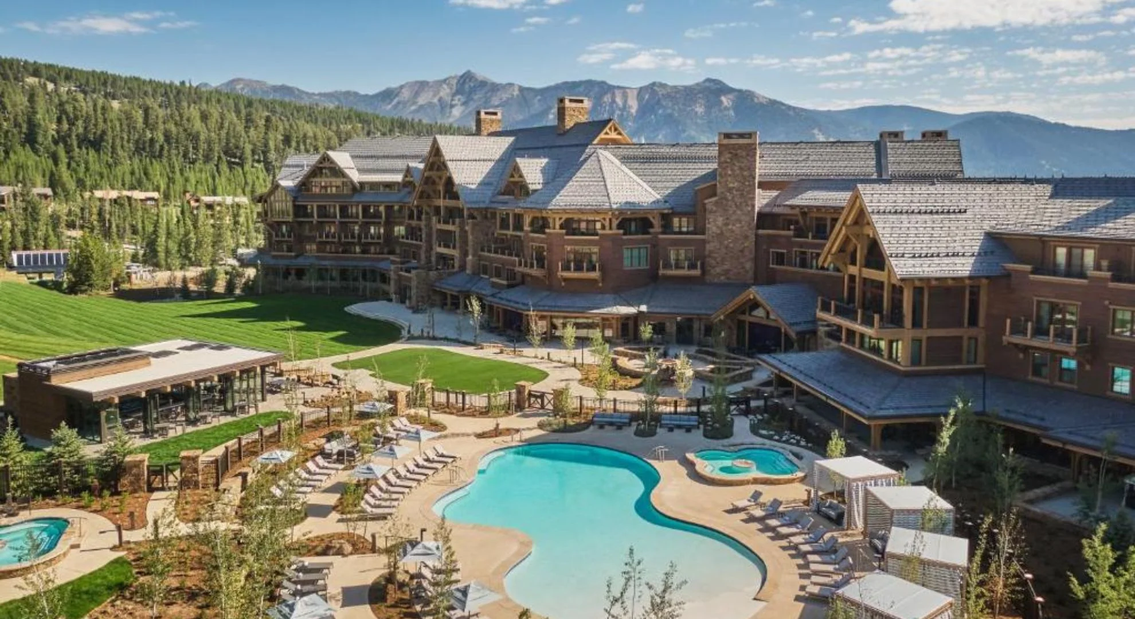
Problem Identification
Big Mountain Resort is a ski resort located in Montana
With spectacular views of Glacier National Park and Flathead National Forest.
Having 350,000 people ski or snowboard per year.
Big Mountain Resort has recently installed an additional chair lift to help increase the
distribution of visitors across the mountain.
increases their operating costs by $1,540,000 this season.
We believe Big Mountain is not capitalizing on its facilities as much as it could.
So, the question is how do we keep the current profit
margins or increase profit margins by capitalizing
on Big Mountain Facilities?

Slide 3
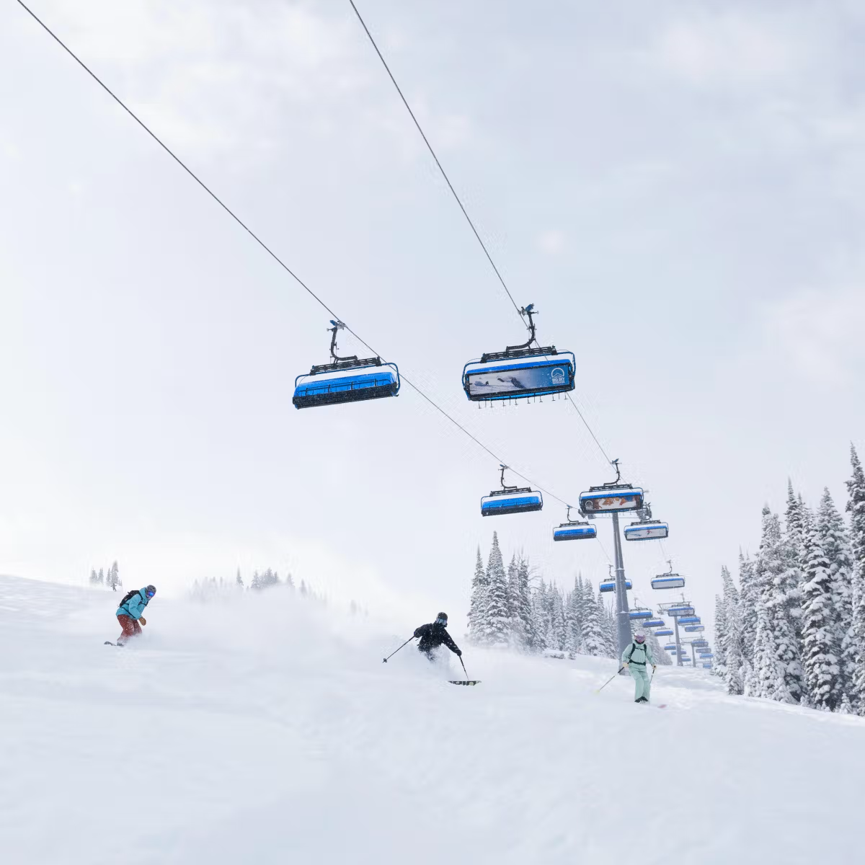
Problem Identification
We could:
increasing the number of operational days
increasing ticket cost
reducing the number of runs
reducing the total skiable area to reduce operations.
.

Slide 4
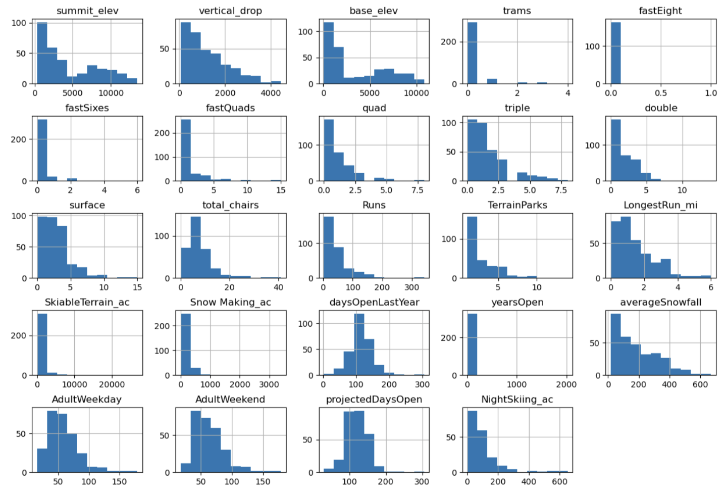
Modeling Results and Analysis
Looking at the distribution of each column features of concern were identified.
SkiableTerrain_ac and Snow Making_ac values being clustered down the low end
half the values of fistfight were missing
most values of fastSixes and trams are 0
Values in yearsOpen are low with a maximum of 2019
Two new ratios (resorts_per_100kcapita and resorts_per_100ksq_mile) were calculated to take into account the population of the state.
Both values were scaling and standardization.
PCA was Fit and transformed using the scaled data.

Slide 5
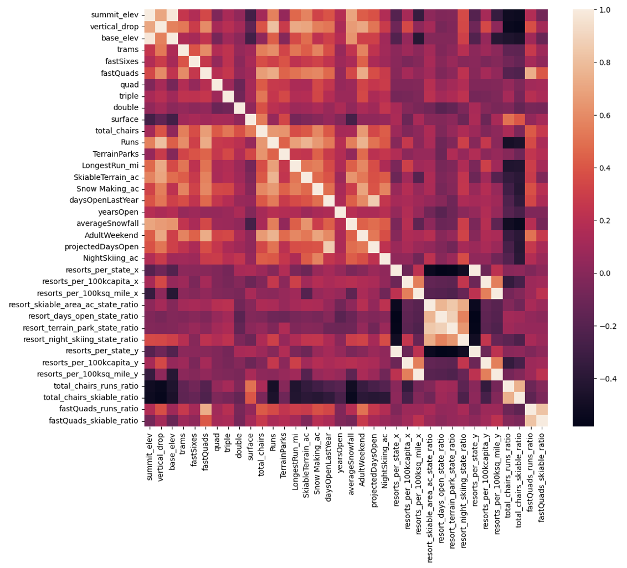
Modeling Results and Analysis
The Heat map shows:
that summit and base elevation are quite highly correlated
some positive correlation between the ratio of night skiing area with the number of resorts per capita
AdultWeekend ticket price is correlated with fastQuads, Runs, Snow Making_ac, and resort_night_skiing_state_ratio
Runs and total_chairs is correlated with the ticket price.

Slide 6
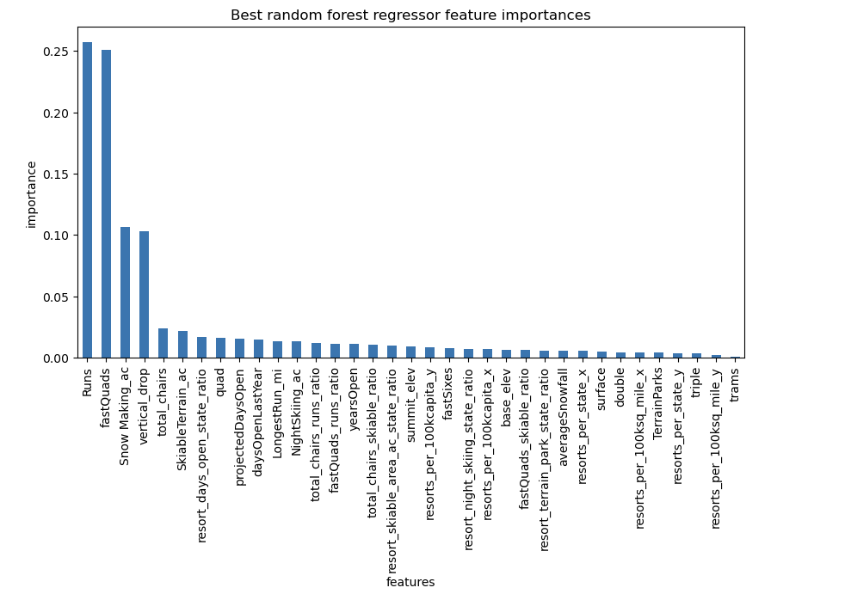
Modeling Results and Analysis
To adjust any missing values the median was found to be the best estimate.
The random forest model had a lower cross-validation mean absolute error of almost $1 and was found to be the best model.
The dominant top four features that are in common with other models tested were fastQuads, Runs, Snow Making_ac, and vertical_drop.
Using the model different scenarios for the business-selected options were run based on the assumption that the expected number of visitors over the season is 350,000 and, on average, visitors ski for five days.

Slide 7
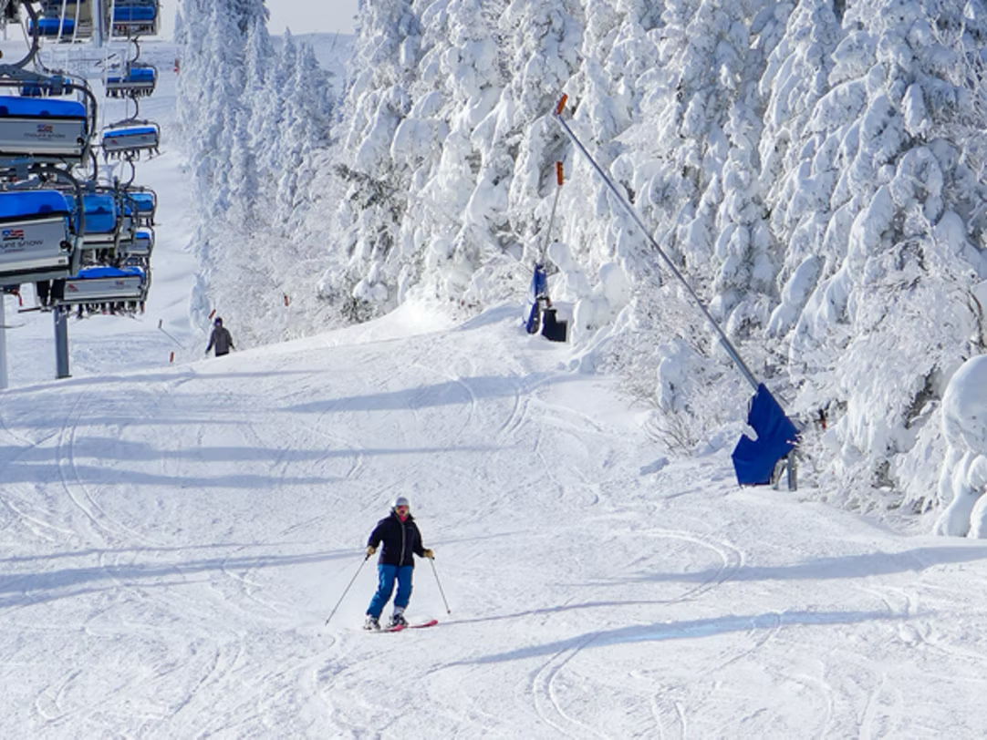
Modeling Results and Analysis
Scenario one: Close at most 10 of the least used runs.
closing 1- run makes no difference.
closing 2 and 3- successively reduces support for ticket price so revenue
may as well close down 4 or 5 as there's no further loss in ticket price.
Increasing the closures down to 6 or more leads to a large drop.
Scenario Two: Big Mountain would add a run, increasing the vertical drop by 150 feet, and installing an additional chair lift.
increases the ticket price by 2 dollars and 22 cents (3888889 dollars over the season)
Scenario Three: Big Mountain would add a run, increasing the vertical drop by 150 feet, thus installing an additional chair lift and adding two acres of snowmaking.
same increase for ticket prices as scenario two.
Scenario Four: calls for increasing the longest run by .2 miles and guaranteeing its snow coverage by adding 4 acres of snow-making capability.
But this scenario makes no difference at all

Slide 8
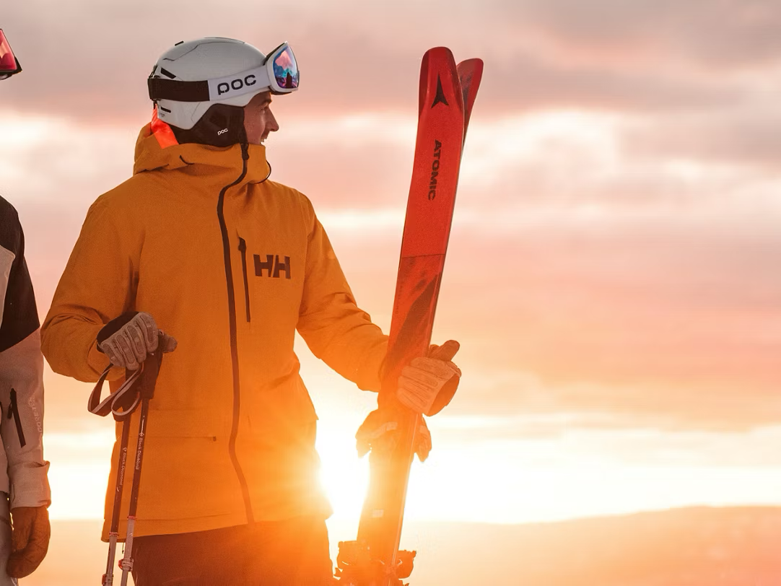
Key Findings and Recommendations
Big Mountain should implement scenario two, where Big Mountain would add a run, increase the vertical drop by 150 feet, and install an additional chair lift.
Adding $2.22 to the ticket price allows an additional $3,888,889 increase in one season.
Overall, the available opportunities to increase the capitalization of current facilities at the Big Mountain resort while keeping profit margins at or above 9% were the intent.
Scenario two was the most profitable seen in the scenarios that were tested.
Many other scenarios could be tested and can be used to determine if it is better for the company. I suggest using the model to create a friendly interface that would allow business analysts to test however many scenarios they like.
In the future, sourcing and incorporating operational costs and number of visitors could improve the model. It would also help improve the model if the market was surveyed for willingness to pay premium prices.

Slide 9
Big Mountain should implement scenario two adding $2.22 to the ticket price allowing an additional $3,888,889 increase in one season.
This capitalization allows profit margins to stay at/above 9%
Conclusion

